Slide 1

Airplane Crashes and Fatalities Since 1908

Slide 2
The Dataset: -
Date: - date the crash had taken place
Time : - time the crash had taken place
Location : - location of Airplane crash
Operator : - Operator of Airplane
Flight # : - Flight Number
Route : - Route of Flight
Type : -Type of Flight
Registration : - Registration number
Aboard : - Total Number of people onboard
Fatalities : - Deaths onboards
Ground : - Deaths on ground

Slide 3
Task
How can we represent Airplane Crashes and the number of fatalities on the map?
How can we analyze which operator has most airplane crashed and numerous Fatalities?
How can we show which year had a more significant number of fatalities?
Total Number of Deaths on Ground and Onboard

Slide 4
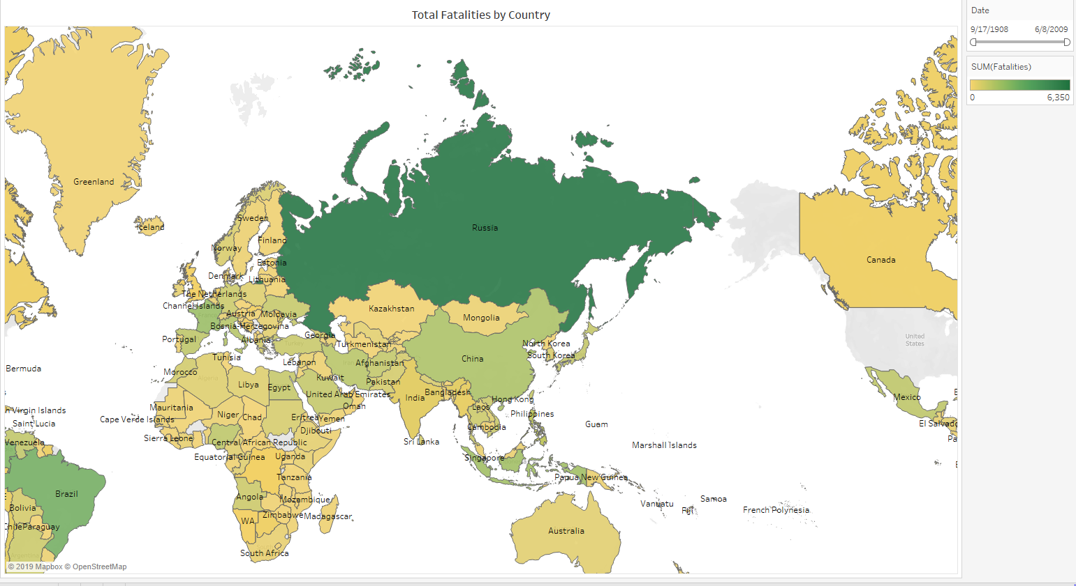
Total Number of Fatalities by Country

Slide 5
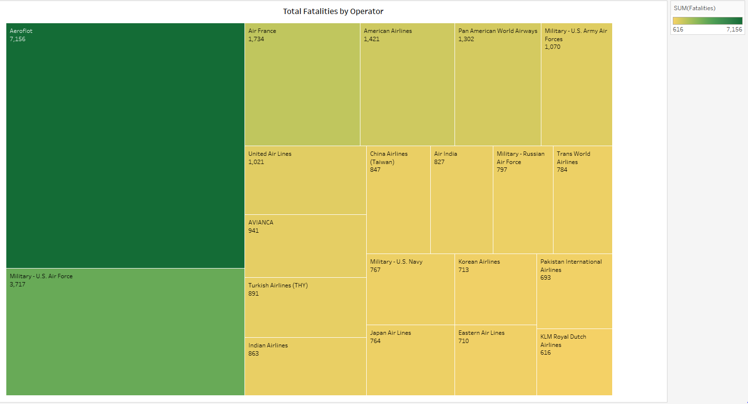
Top 20 operators which have caused more number of fatalities

Slide 6
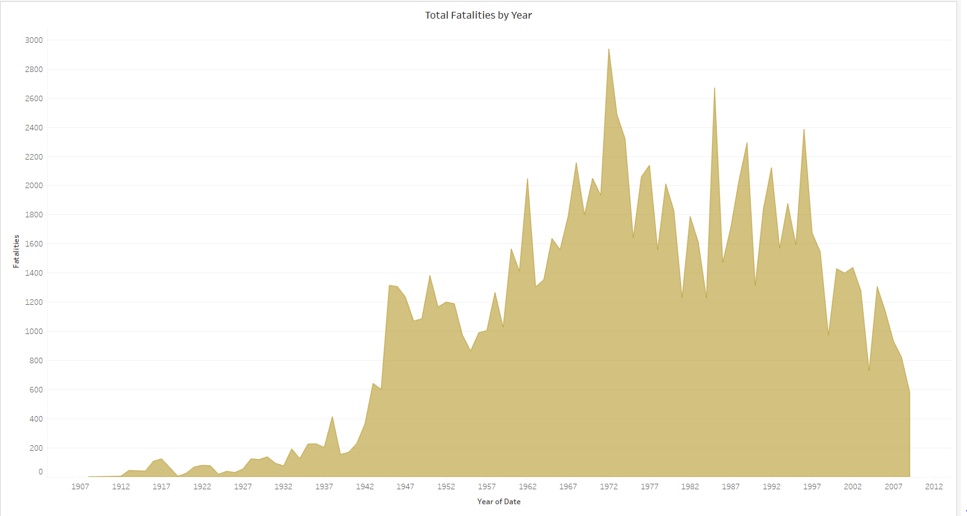
Total Deaths by Year

Slide 7
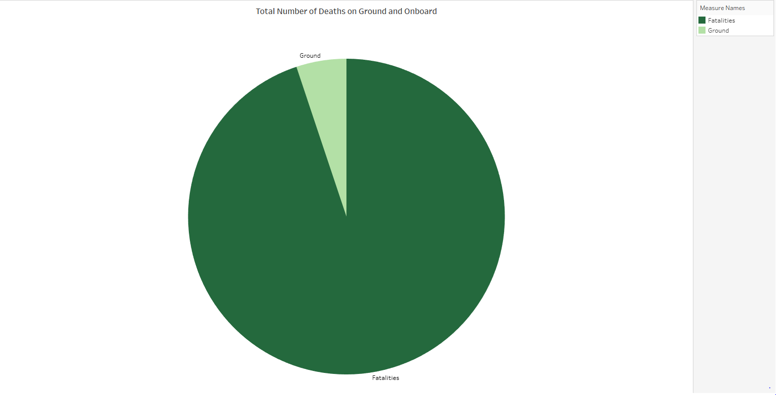
Total Number of Deaths on Ground and Onboard

Slide 8
Thank You

